Slide 1

Price searchers: Monopoly and Monopolistic Competition
Professor Nico Voigtländer
Management 405: Module 5

Slide 2
agenda for the class
1. The Economic Way of Thinking
2. Value and Demand
3. Supply and Cost
4. Markets, Pricing and Strategy

Slide 3
OUTLINE of module 5
Profit maximization for price searchers
  Markup and Lerner index
Monopoly and welfare impact
Rising market power and regulations
Monopolistic competition

Slide 4
the four basic market structures
Use the same analytics to find optimal price/quantity
 | Perfect competition | Monopolistic competition | Oligopoly | Monopoly
Number of Firms
Type of Products Sold
Barriers to Entry
Many
Identical
None
Many
Differentiated
None
Few
Identical or Differentiated
Some
One
Unique
Many

Slide 5
OUTLINE of module 5
Profit maximization for price searchers
  Markup and Lerner index
Monopoly and welfare impact
Rising market power and regulations
Monopolistic competition

Slide 6
Firm Demand:
Price takers vs. price searchers
Price taker
Price searcher
Price
Price
P_{M}
D=P_{M}=MR
D
MR
Output
Output
The demand curve faced by a price taker is the market price (which in turn equals MR for a price taker)
The demand curve faced by a price searcher is downward-sloping
Marginal Revenue (MR) is different from the demand curve (D)

Slide 7
Test of market power
If we raise our price, will we lose all our customers?
  “yes” → Price taker
    We have no market power
  “no” → Price searcher
    We have market power!
    We face a downward-sloping demand curve

Slide 8



Profit maximization for price searcher
Profit maximization for price searchers
$$MR=MC$$
P
$$Q = 1,600 – 4P$$
$$→P=400−0.25Q$$
(Estimated demand curve)
(inverse demand → what we plot)
P*=$300
MR is derived from the (inverse) demand curve
MC=$200
MC
$$MR=MC$$
Teaching Note MR=MC
D
Q*=400
Q
MR

Slide 9

Profit maximization Of a Restaurant
Practice Video!

Slide 10

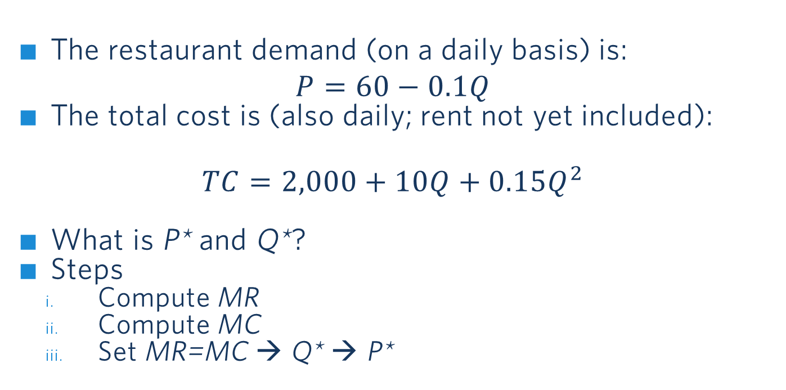
This is from the Practice Video:
Profit maximization for a Restaurant
The restaurant demand (on a daily basis) is:
$$P=60−0.1Q$$
The total cost is (also daily; rent not yet included):
$$TC=2,000+10Q+0.15Q^{2}$$
What is P* and Q*?
Steps
  Compute MR
  Compute MC
  Set MR=MC → Q* → P*
TC
Q
In class, we will focus on the graphics/intuition. Watch the Practice Video for Exam Prep!
Notes:
Total cost per day in a restaurant: 8,000 of which 3,000 food, 3,000 labor, 2,000 other
TC=2,000+60Q
Q=meal per day
At P=50 and 200 people, 10,000 revenue, profit=2,000

Slide 11
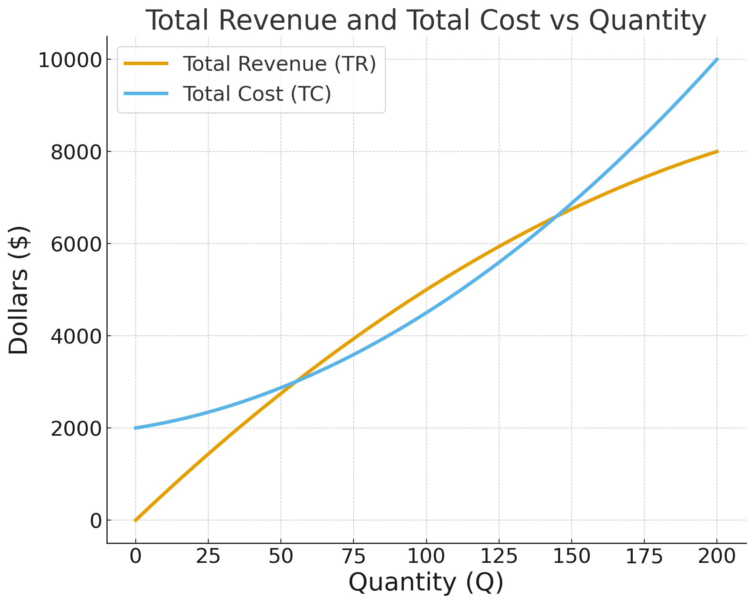
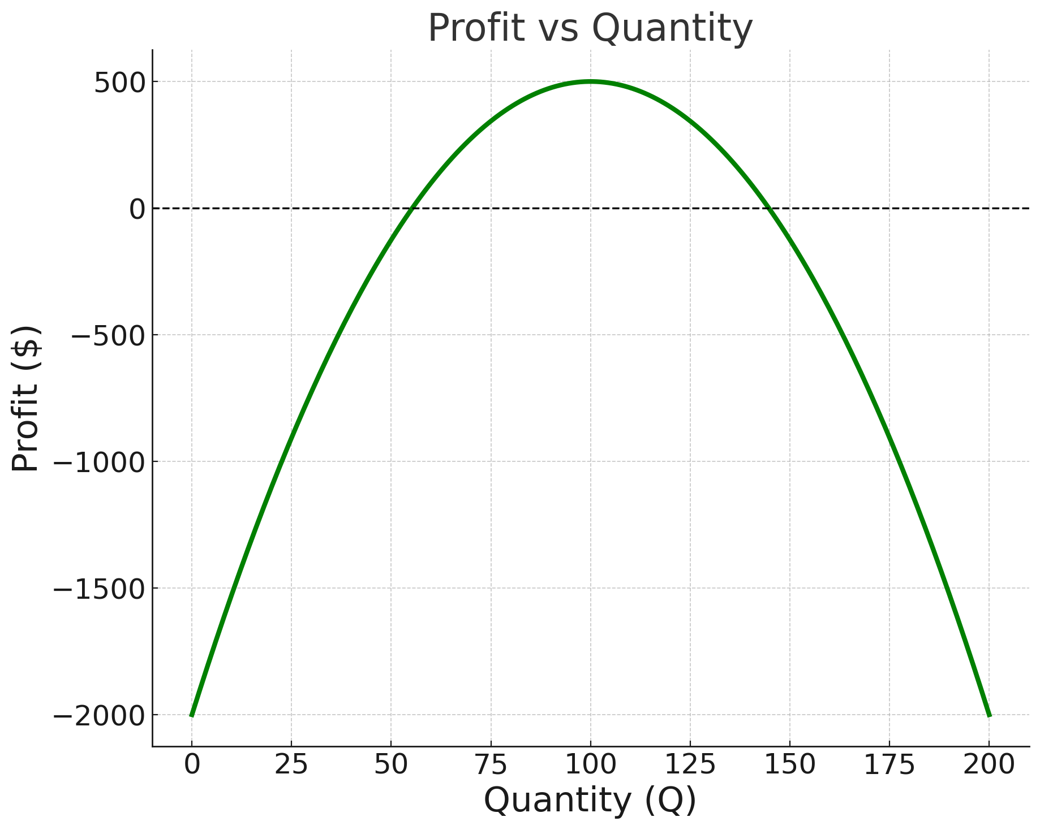
Illustration of the Practice Video Example: Profit Maximization
To find the profit-maximizing quantity, use marginal analysis (MR=MC)

Slide 12
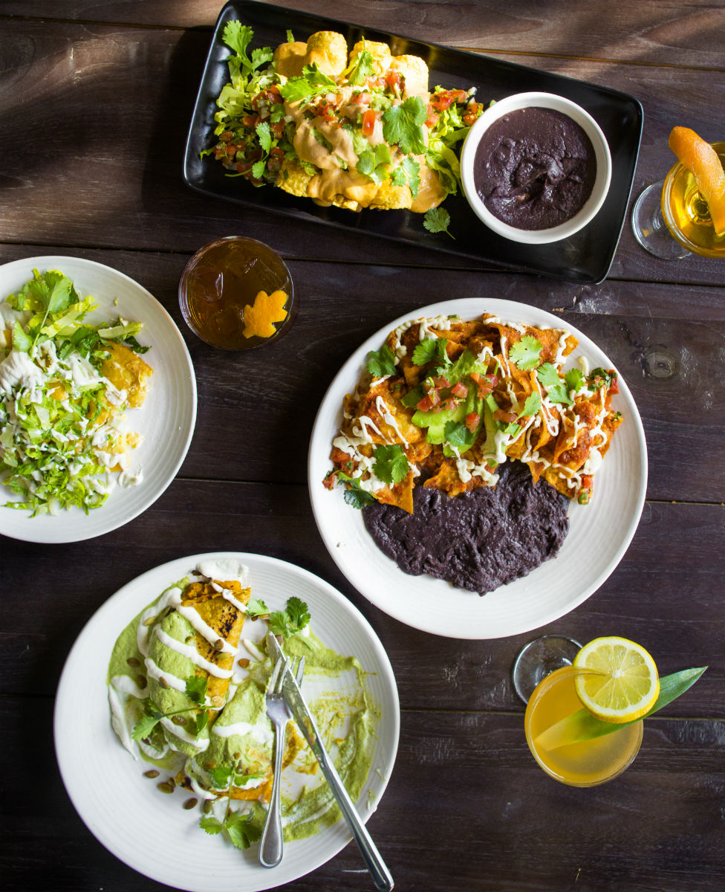
price searcher: Maximizing Profit
Price
Profit
MC
P*
ATC
ATC
D
Q*
Output
MR
Now suppose: Rent increases → ATC moves up (next slide)
Notes:
Gracias Madre is a plant-based Mexican restaurant in west-Hollywood.
https://www.graciasmadre.co/
To maximize profit, monopolist sets MC=MR — only difference with respect to perfect competition is that under perfect competition MR=P, but that is no longer the case for a monopolist.

Slide 13
price searcher: minimizing loss
Price
Loss
MC
ATC
ATC (with higher rent)
P*
Contribution
to TFC
AVC (needed to check if we stay
in business in the short run)
AVC
MR
D
Q*
Output
Output
Negative economic profits (losses) are being made because P* < ATC.
But P* > AVC → The firm should continue to produce, to cover part of its TFC.

Slide 14
Loss when Stopping to Produce in the short run
Price
MC
ATC
ATC (with higher rent)
P*
Loss
(=TFC)
AVC
AVC
MR
D
Q*
Output
Output
If the restaurant stops serving customers but still has to pay the rent, it loses the
whole fixed cost (TFC), which is equal to the rent

Slide 15
Price searcher:
Fixed Cost Does Not Impact Price
Price
MC
ATC (with higher rent)
P*
ATC (with lower rent)
P* does not
change if fixed
costs go up
MR
D
Q*
Output
Output
When fixed costs (and thus ATC) increase, P* does not change. But profits fall.

Slide 16
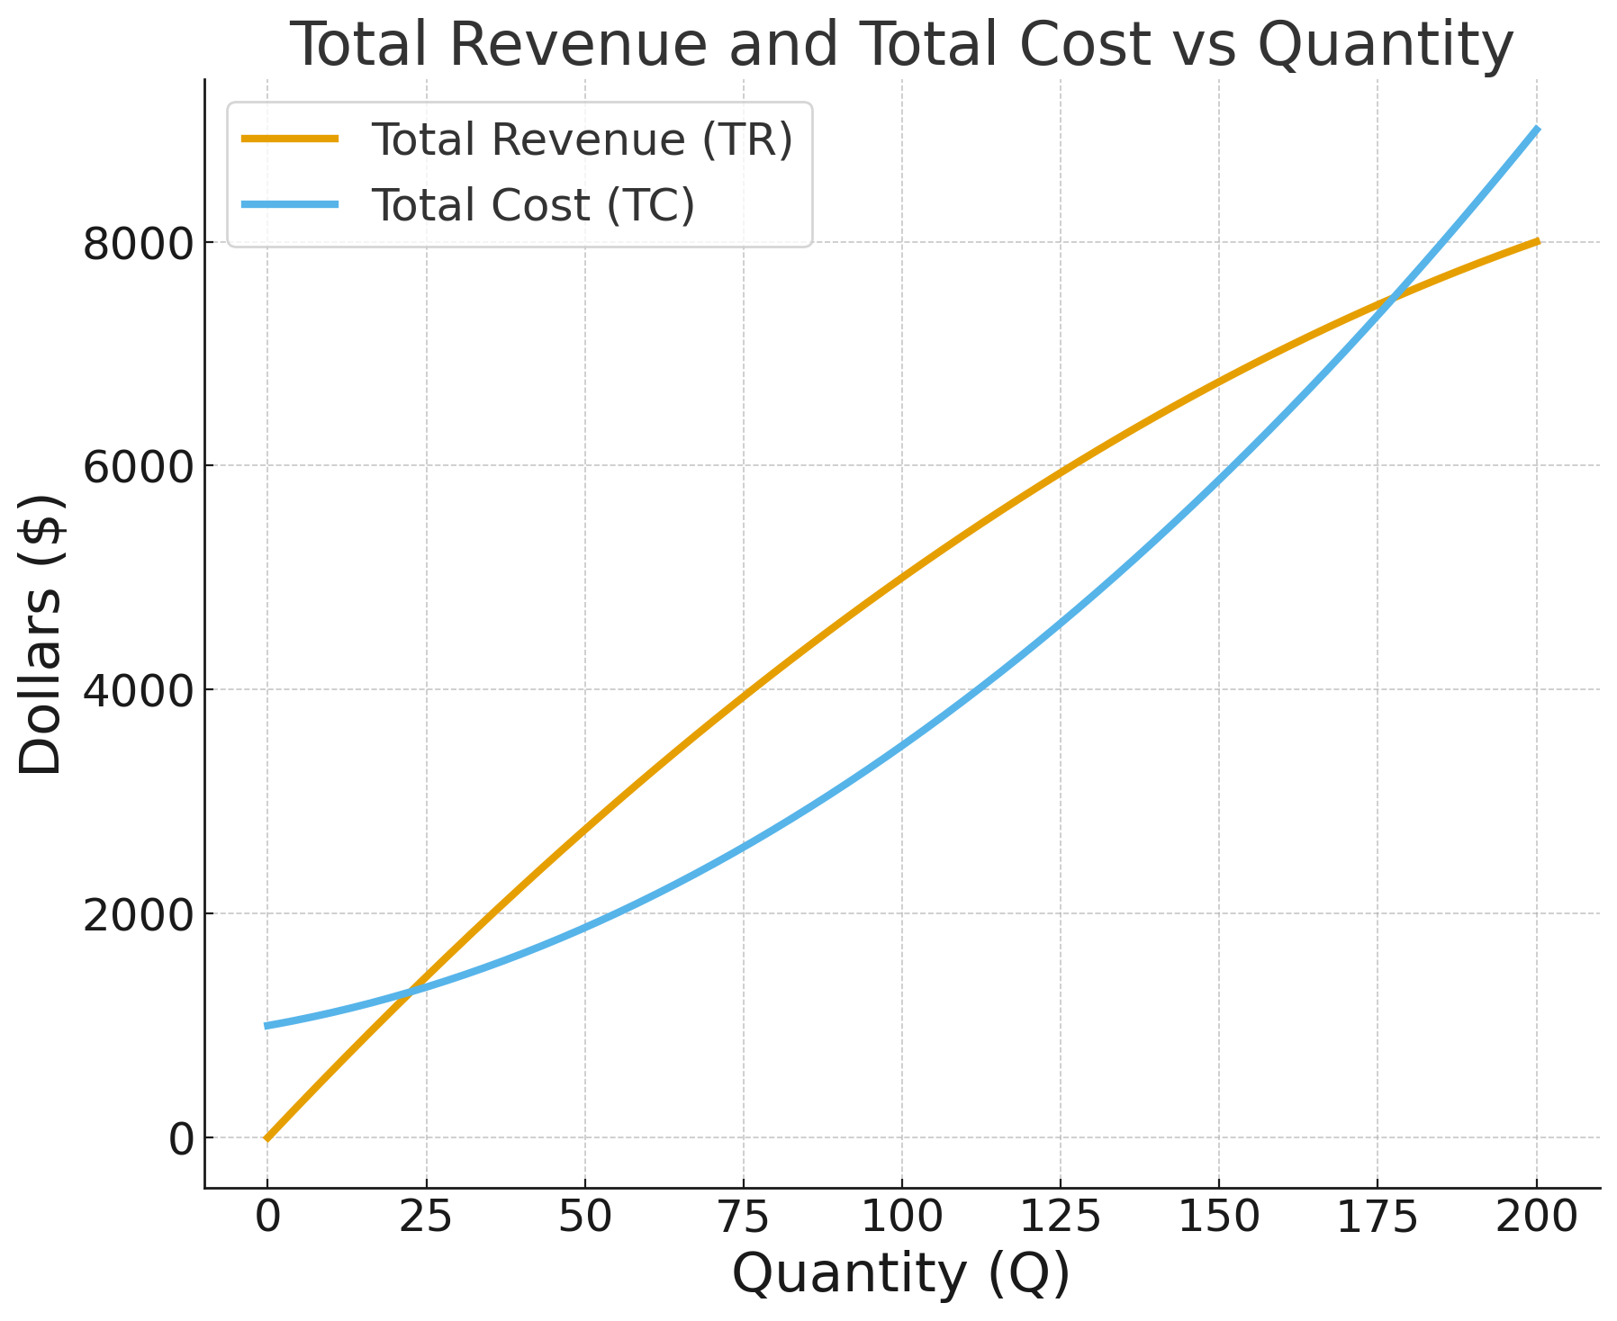
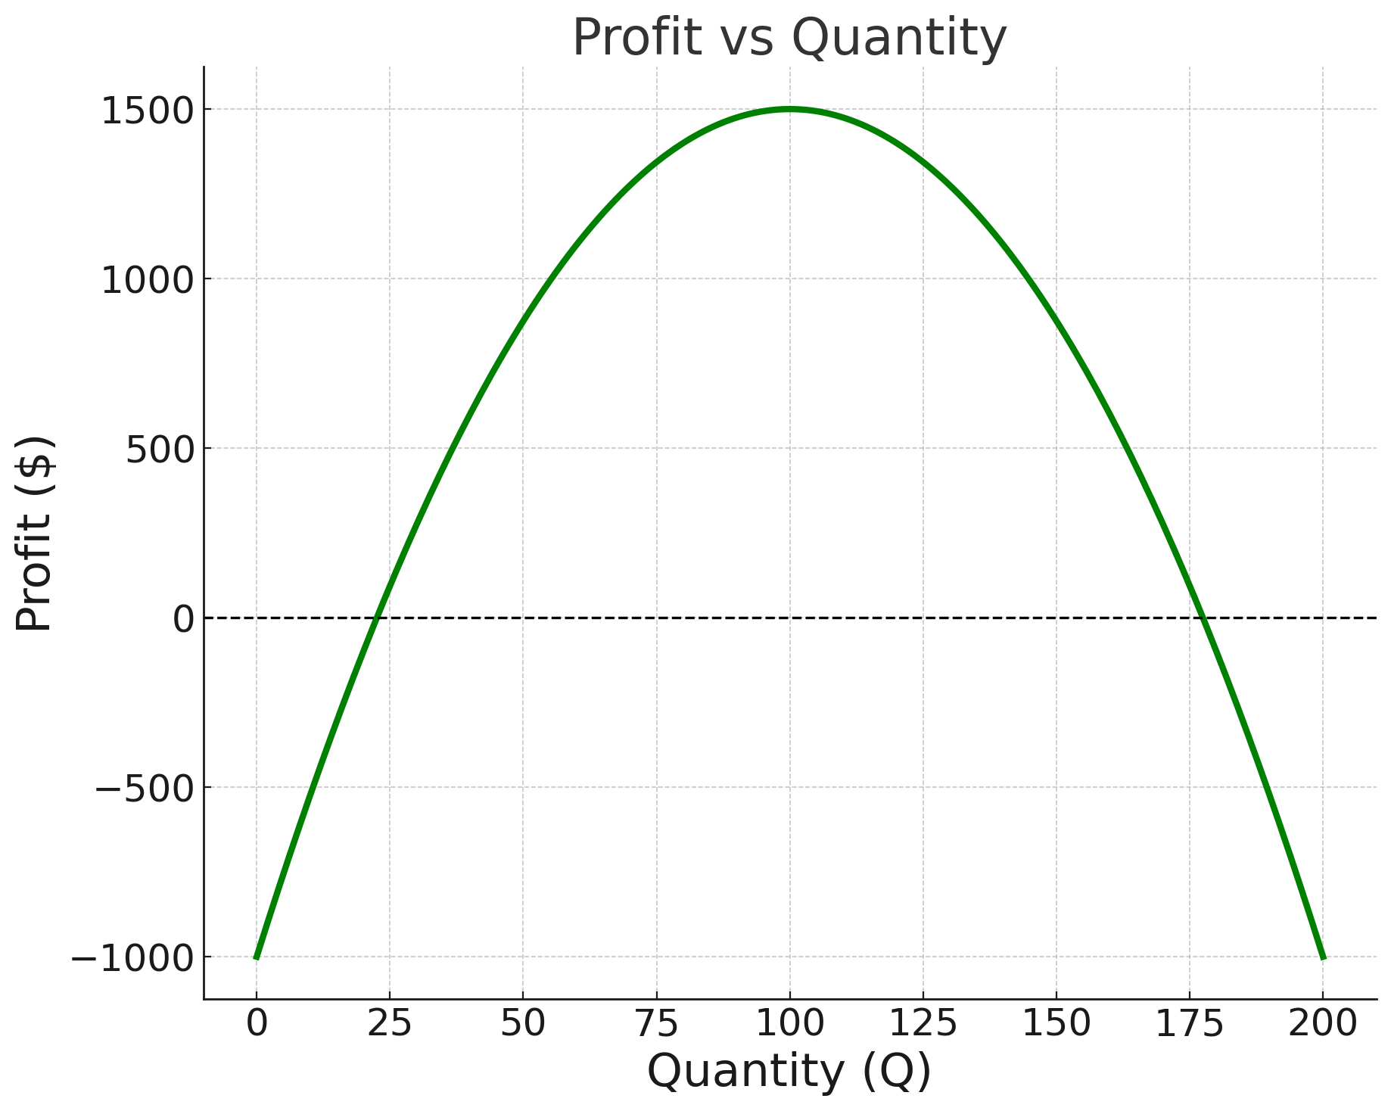
Illustration based on the Practice Video Example
Case 1: Low Fixed Cost (Rent $1000)

Slide 17
Illustration based on the Practice Video Example
Case 2: Medium Fixed Cost (Rent $2000)

Slide 18
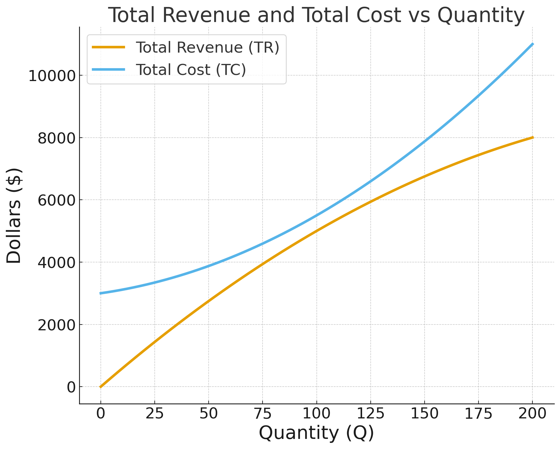
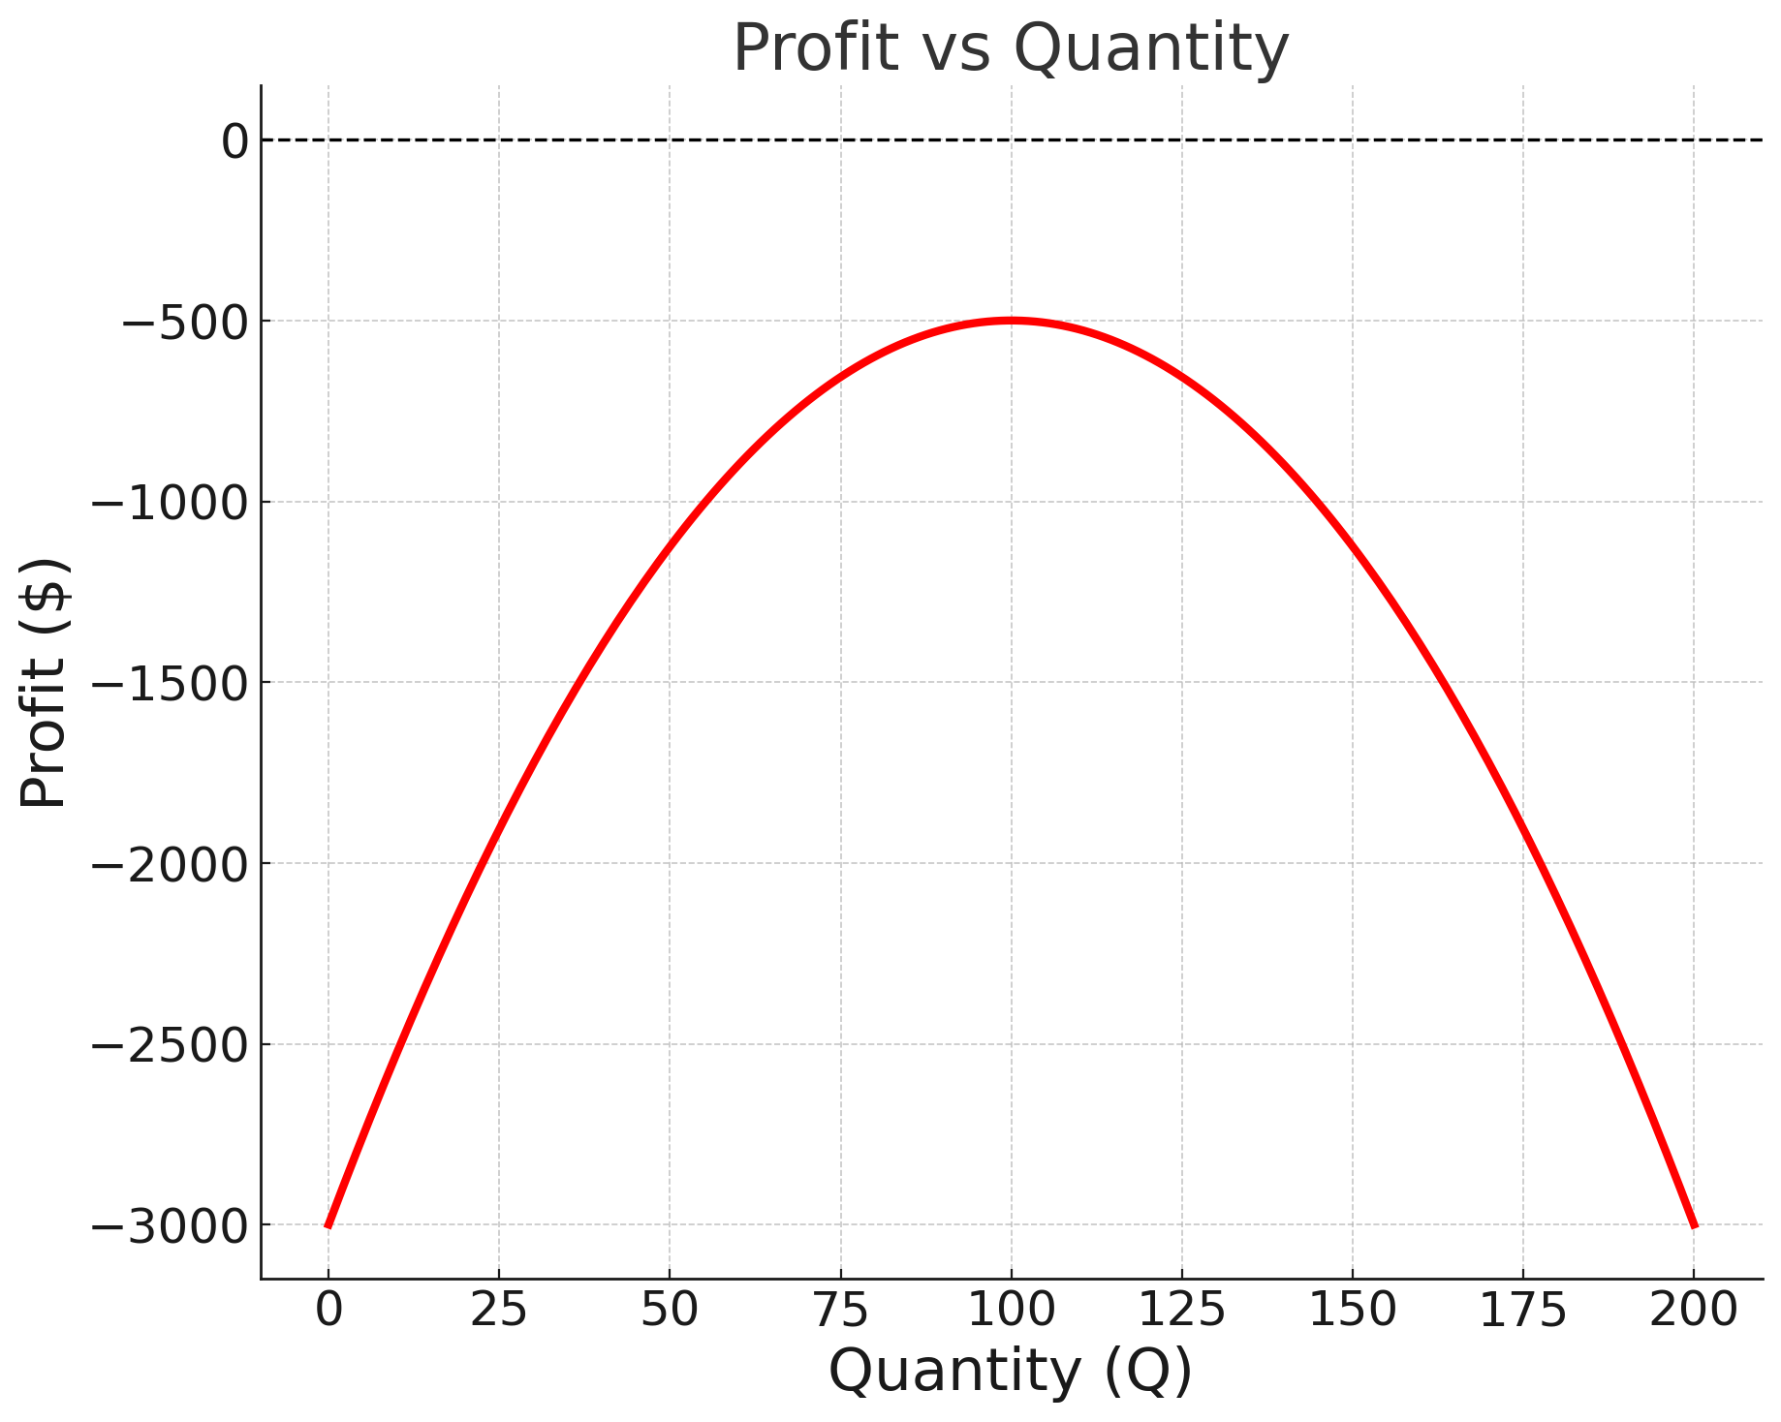
Illustration based on the Practice Video Example
Case 3: High Fixed Cost (Rent $3000)
→ In all three fixed-cost cases, the profit-maximizing quantity remains the same

Slide 19
OUTLINE of module 5
Profit maximization for price searchers
  Markup and Lerner index
Monopoly and welfare impact
Rising market power and regulations
Monopolistic competition

Slide 20
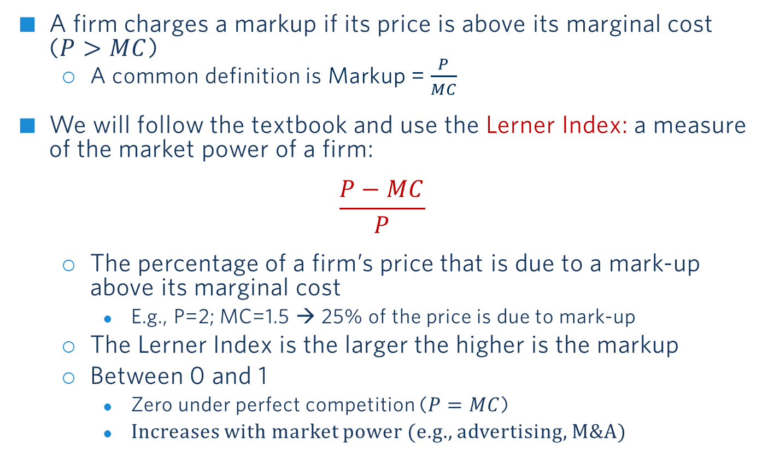
Markup and The Lerner index
A firm charges a markup if its price is above its marginal cost ($P>MC$)
  A common definition is Markup = $\frac{P}{MC}$
We will follow the textbook and use the Lerner Index: a measure of the market power of a firm:
$$\frac{P−MC}{P}$$
  The percentage of a firm’s price that is due to a mark-up above its marginal cost
    E.g., P=2; MC=1.5 → 25% of the price is due to mark-up
  The Lerner Index is the larger the higher is the markup
  Between 0 and 1
    Zero under perfect competition ($P=MC$)
    Increases with market power (e.g., advertising, M&A)

Slide 21
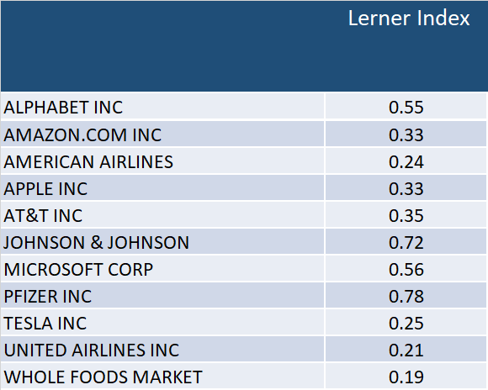

Lerner Index for Major US Companies
$$\frac{P−MC}{P}$$
Source: De Loecker et al. (2019)
Notes:
Reference: https://www.janeeckhout.com/wp-content/uploads/RMP.pdf Table 5.1.
Note that markup refers to MC and not AVC

Slide 22
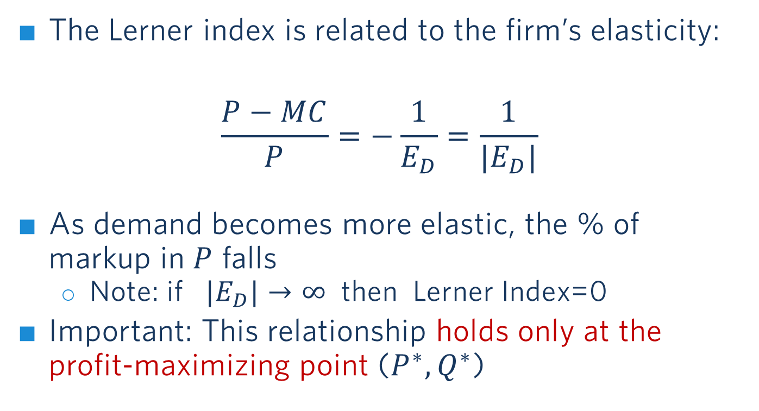
Lerner index
The Lerner index is related to the firm’s elasticity:
$$\frac{P−MC}{P}=−\frac{1}{E_{D}}=\frac{1}{{|E}_{D}|}$$
As demand becomes more elastic, the % of markup in $P$ falls
  Note: if ${|E}_{D}|→∞$ then Lerner Index=0
Important: This relationship holds only at the profit-maximizing point ($P^{∗},Q^{∗}$)
The elasticity of demand has a negative value

Slide 23



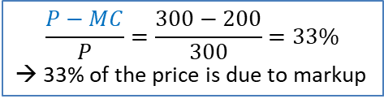


Illustrating the Lerner INdex
Using example from above: $Q = 1,600 – 4P;MC=200$
P
Lerner Relationship holds only at the profit-max point!
$$\frac{P−MC}{P}=\frac{1}{{|E}_{D}|}$$
At the profit-max point:
$$E_{D}=\frac{dQ}{dP}\frac{P^{∗}}{Q^{∗}}=−4\frac{300}{400}=−3$$
Thus: $\frac{1}{{|E}_{D}|}=\frac{1}{3}=33\%$ ✓
P*=$300
$$P−MC$$
MC=$200
MC
$$MC$$
D
Q*=400
Q
MR
$$\frac{P−MC}{P}=\frac{300−200}{300}=33\%$$
→ 33% of the price is due to markup

Slide 24
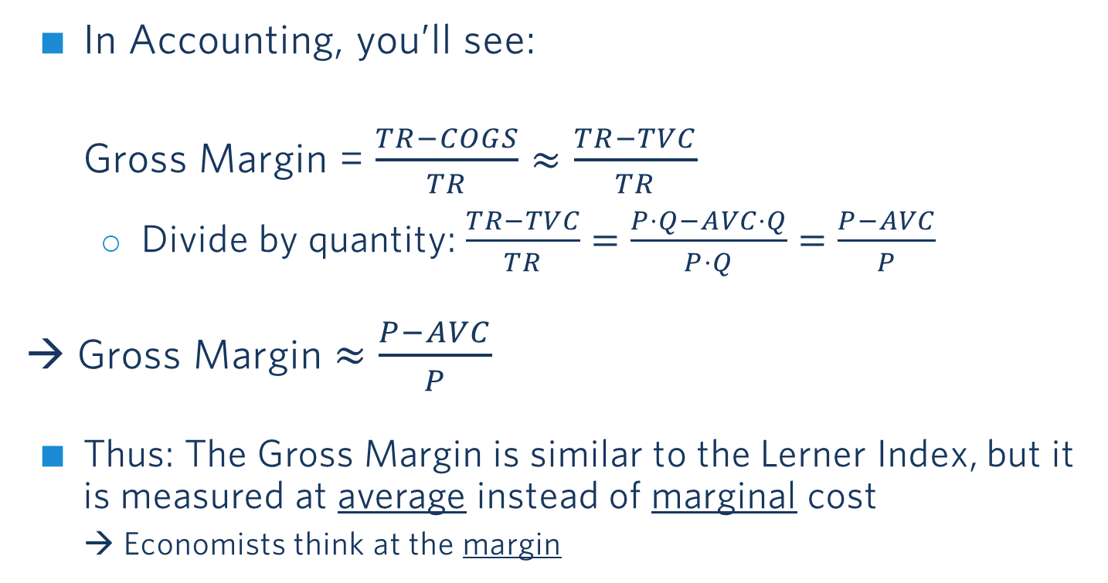


Lerner index – Relationship to Accounting
(for your notes later, when you take accounting)
In Accounting, you’ll see:
Gross Margin = $\frac{TR−COGS}{TR}≈\frac{TR−TVC}{TR}$
  Divide by quantity: $\frac{TR−TVC}{TR}=$ $\frac{P⋅Q−AVC⋅Q}{P⋅Q}=$ $\frac{P−AVC}{P}$
→ Gross Margin $≈$ $\frac{P−AVC}{P}$
Thus: The Gross Margin is similar to the Lerner Index, but it is measured at average instead of marginal cost
→ Economists think at the margin
“Cost of Goods Sold” $≈$TVC
Average variable cost
Learner Index:
$$\frac{P−MC}{P}$$
Notes:
From Henry Friedman (Accounting Prof):
COGS is cost of goods sold. It’s about as close to a pure variable cost as you’re going to get. It’s basically what it cost the firm to get the stuff that it sells. For a merchandising or wholesaling firm, it’s basically the purchase price of inventory, though some shipping and wharehousing costs might be included. For a manufacturing firm, you’d also have some fixed costs (e.g,. assembly facility rent, production line manager and insurance) included, as these are allocated to inventory.
For a service company, you might have a similar Cost of Services Sold (or cost of revenue) line, which for instance, would be the cost of consultants on a consulting team, but not the cost of the consulting firm’s management.
Linking back to markups, Gross margins, or (Revenue – COGS)/Revenue are close the Lerner index, as dividing the numerator and denominator by Q gets you to (P – AVC)/P, though the AVC here is average variable cost related to inventory specifically. There could be other variable costs, like sales commissions, that come into play. Still though, Gross margins are really close to the Lerner Index.

Slide 25
Firm and market elasticity
Note that the Lerner index is calculated based on the firm elasticity
Important:
Firm and market elasticity are generally different
Firm elasticity tends to be larger than market elasticity, especially if there are many firms competing in an industry
Across firms, those with more differentiated products tend to face lower elasticities

Slide 26
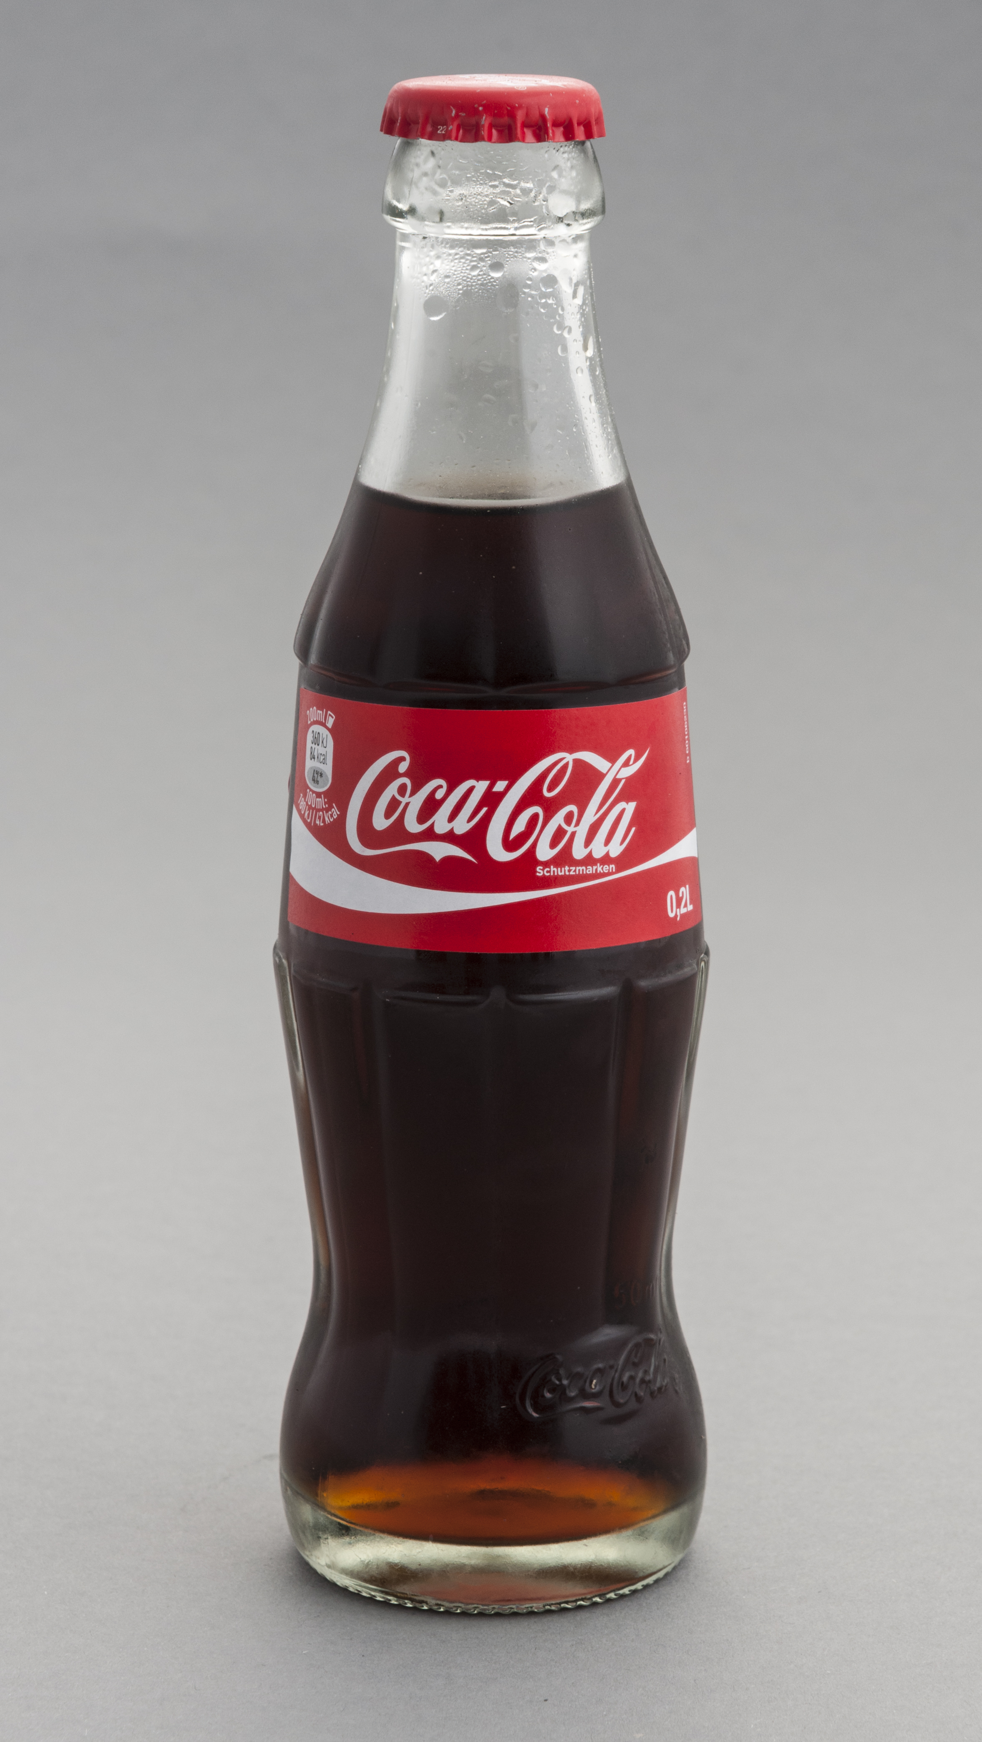
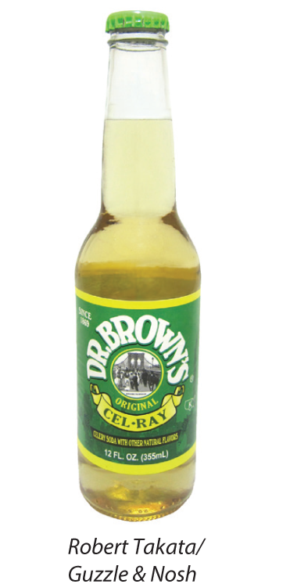
Mark-up and elasticity
Coca Cola’s demand elasticity is -4.1
Dr. Brown’s Cel-Ray has a demand elasticity of -2.0
What is the % of the price that is due to markup for the two products?
Note: You may assume that elasticities are for the profit-maximizing P and Q.
Poll Break
Notes:
Prepare poll-ev Consider Coca-Cola and Dr Brown, which has the higher mark-up?
Elasticity is lower because of nich product

Slide 27
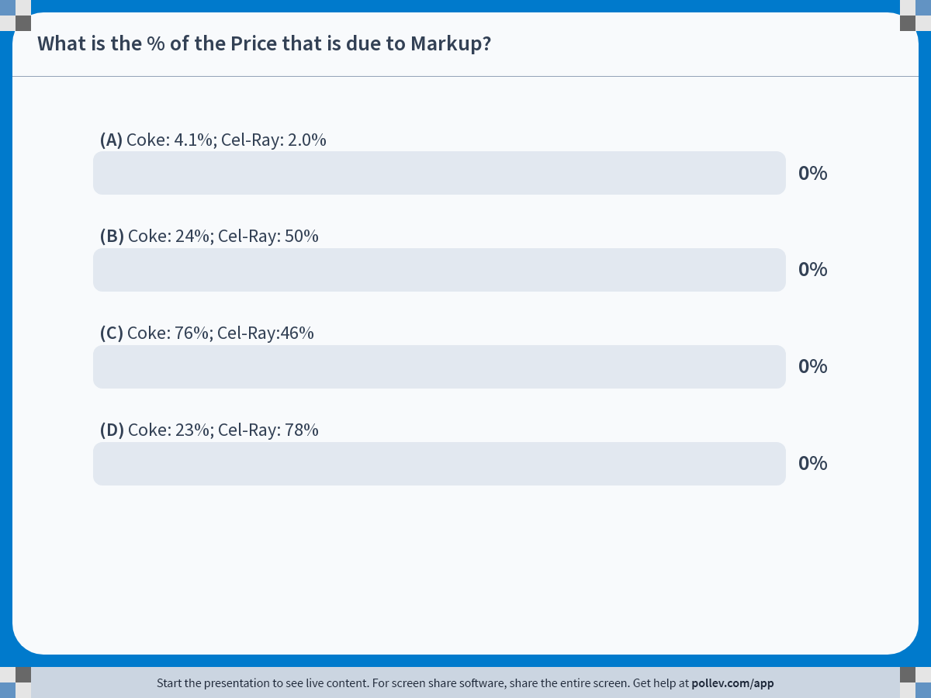
Notes:
Poll Title: Do not modify the notes in this section to avoid tampering with the Poll Everywhere activity.
More info at polleverywhere.com/support
What is the % of the Price that is due to Markup?
https://www.polleverywhere.com/multiple_choice_polls/N7b4Z8mD8cUApKIyTWkWe?state=opened&flow=Default&onscreen=persist

Slide 28
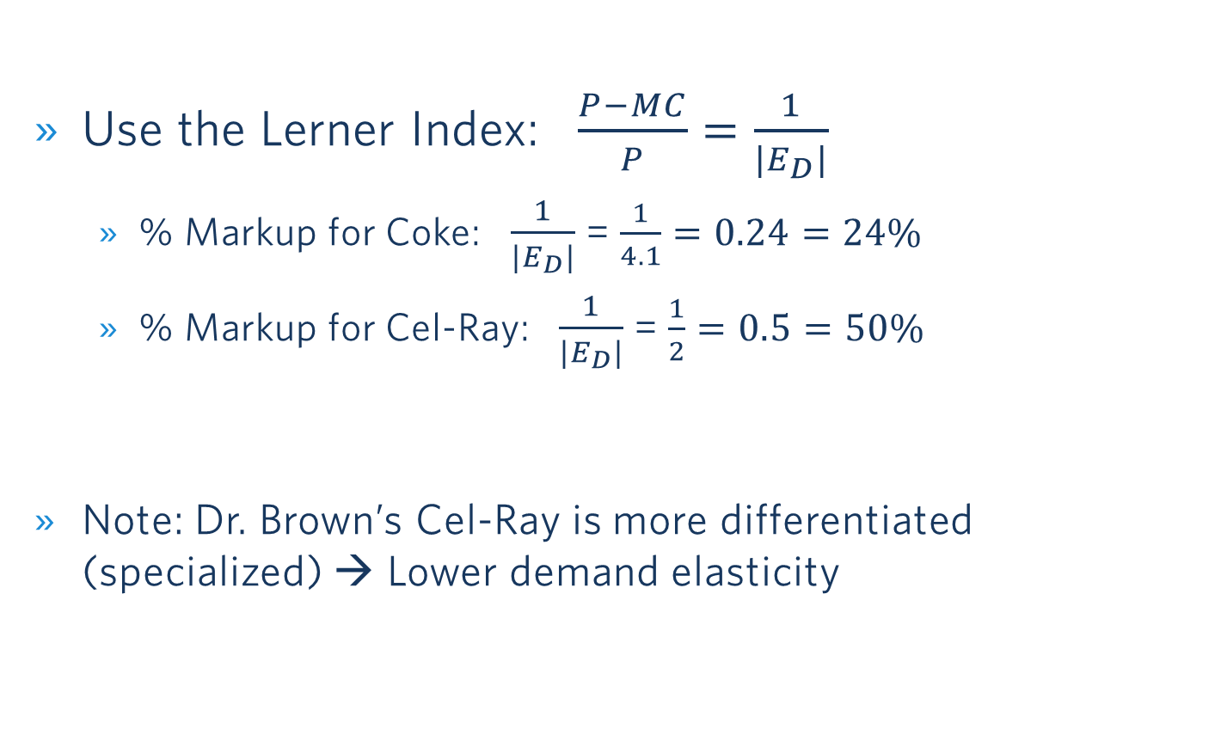
Solution
Use the Lerner Index: $\frac{P−MC}{P}=\frac{1}{{|E}_{D}|}$
  % Markup for Coke: $\frac{1}{{|E}_{D}|}$=$\frac{1}{4.1}=0.24=24\%$
  % Markup for Cel-Ray: $\frac{1}{{|E}_{D}|}$= $\frac{1}{2}=0.5=50\%$
Note: Dr. Brown’s Cel-Ray is more differentiated (specialized) → Lower demand elasticity
Poll Break
Notes:
Prepare poll-ev Consider Coca-Cola and Dr Brown, which has the higher mark-up?
Elasticity is lower because of nich product

Slide 29
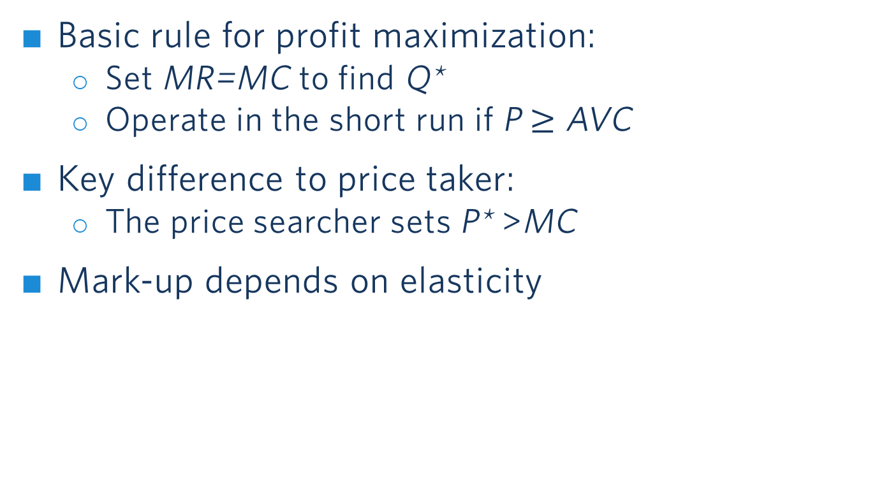
Price searcher Take-aways
Basic rule for profit maximization:
  Set MR=MC to find Q*
  Operate in the short run if P $≥$ AVC
Key difference to price taker:
  The price searcher sets P* >MC
Mark-up depends on elasticity

Slide 30
OUTLINE of module 5
Profit maximization for price searchers
  Markup and Lerner index
Monopoly and welfare impact
Rising market power and regulations
Monopolistic competition

Slide 31

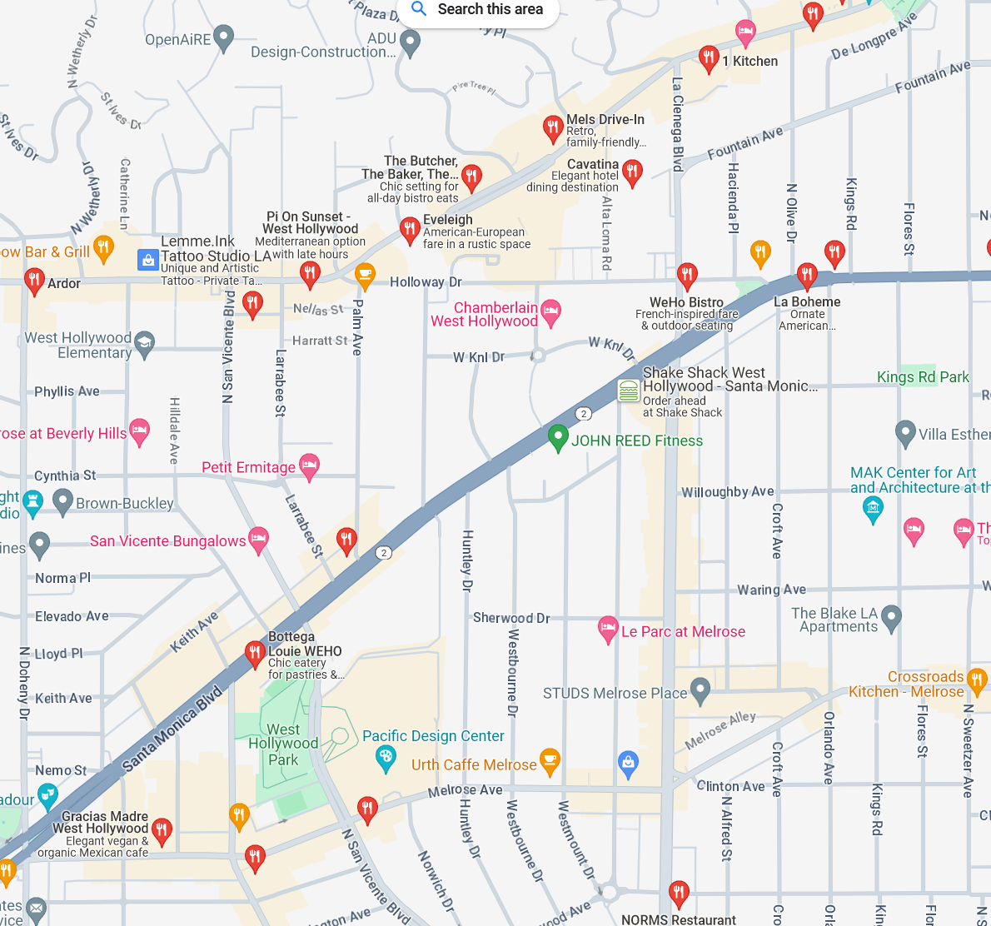



Where We Are and
Where We Are Going
WE ARE HERE
Least Market Power
Most Market Power
Perfect
Competition
Monopolistic
Competition
Oligopoly
Monopoly
(Price Takers)
(Price Searchers)
Restaurants in WeHo

Slide 32

Market structure characteristics
Monopoly
Number of actual or potential
competitors
Product differentiation
Entry conditions
Profit potential
Examples
Single seller
Very high – no close substitutes
Restricted access (barriers)
Profit potential in short and long run
Microsoft (before the rise of Apple);
gas, water and electric utilities
Notes:
Article on att-time-warner merger
https://www.cnn.com/2019/02/26/media/att-time-warner-merger-ruling/index.html
Live Nation / Ticketmaster merger
https://www.nytimes.com/2010/04/25/business/25ticket.html

Slide 33
Recall: Consumer And Producer Surplus under Competition
Price
Consumer surplus
under competition
CS
MC
P_{Comp}
PS
D
Producer surplus under competition
Q_{Comp}
Q
Notes:
Since a monopolist charges a price above the MC, you might suspect that having market power is beneficial for firms. It is! We can characterize the welfare consequences of market power and specify how it affects consumers and the firm.
We compute consumer and producer surplus similar to the competitive market setting.
Consumer surplus: the area under the demand curve and above the price
Producer surplus: the area above the MC curve and below the price. (Recall that a firm’s short run supply curve in a perfectly competitive market is where the MC curve is above AVC.)
Under monopoly (relative to perfect competition):
--consumer surplus declines.
--producer surplus rises.
--total welfare is reduced (deadweight loss of market power).

Slide 34
Monopoly: Good for business, bad for Consumers and Welfare
Price
Consumer surplus
under monopoly
Producer surplus under monopoly
P_{M}
Deadweight loss under monopoly
MC
P_{Comp}
D
MR
Q_{M}
Q_{Comp}
Q
Notes:
Since a monopolist charges a price above the MC, you might suspect that having market power is beneficial for firms. It is! We can characterize the welfare consequences of market power and specify how it affects consumers and the firm.
We compute consumer and producer surplus similar to the competitive market setting.
Consumer surplus: the area under the demand curve and above the price
Producer surplus: the area above the MC curve and below the price. (Recall that a firm’s short run supply curve in a perfectly competitive market is where the MC curve is above AVC.)
Under monopoly (relative to perfect competition):
--consumer surplus declines.
--producer surplus rises.
--total welfare is reduced (deadweight loss of market power).

Slide 35

The case of luxotTica (now Essilor-Luxottica)
Class Discussion
Notes:
https://www.youtube.com/watch?v=gDdq2rIqAlM&t=589s
Watch 0:55 (if time)
Watch from 5:00 – (if less time)
Watch from 6:45 if previously assigned video
Note: Merger with Essilor in 2018: EssilorLuxottica
New entrant: Warby Parker

Slide 36

The case of luxottica
Which type of market is Luxottica operating in?
How do they achieve market power?
Do they have a high markup?
How does the following statement by Luxottica’s former CEO relate to what we learned about the demand curve?
  « Everything is worth what people are ready to pay »

Slide 37
Monopoly Take-aways
Monopolist: Large degree of market power
  Enables high profits
  Reduces consumer surplus
  Reduces overall (society) welfare
Silver lining: Patents, licenses and copyrights
  The prospect of monopoly power provides incentives for innovation (e.g., new drugs)
  Consumer surplus from new product creation can outweigh deadweight loss due to high prices

Slide 38
OUTLINE of module 5
Profit maximization for price searchers
  Markup and Lerner index
Monopoly and welfare impact
Rising market power and regulations
Monopolistic competition

Slide 39
Governments Regulations to control Market Power
Price regulations
  Happens frequently with natural monopolies: electricity, natural gas, (historically: local telephone service)
Antitrust laws
  Scrutiny on mergers/acquisitions that would limit competition
  FTC successfully blocked Kroger’s acquisition of Albertsons in 2024 (~ $24.6 billion)
  Ban collusion on prices
Nevertheless: Very high and rising market concentration in the US
Notes:
Two rationales for regulating monopoly:
-- total welfare
-- allocation of surplus among consumers and producers
For more on the AT&T breakup: http://articles.latimes.com/1995-09-21/business/fi-48462_1_system-breakup
…but many mergers that limit competition still go through. CF Live Nation+Ticketmaster merger in 2010: https://www.vox.com/the-goods/23569504/ticketmaster-monopoly-live-nation-taylor-swift-antitrust-clyde-Lawrence

Slide 40
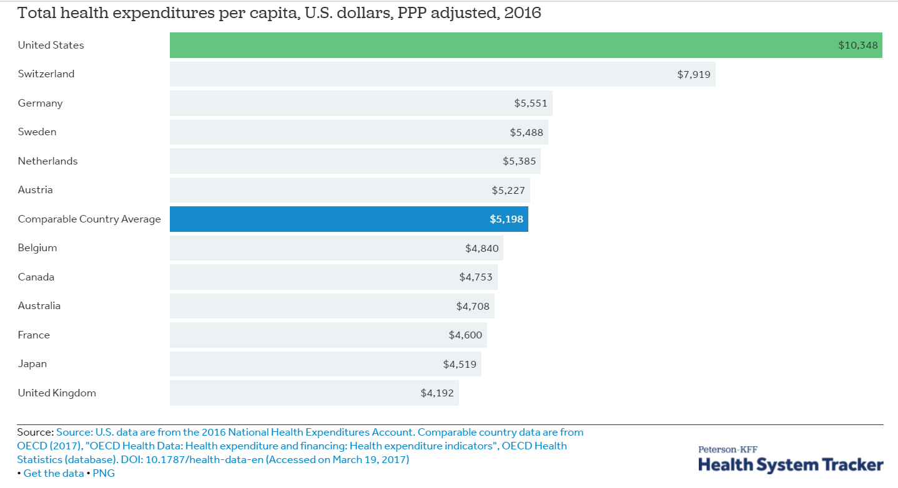
Concentration in health care
Notes:
This website is really cool: https://concentrationcrisis.openmarketsinstitute.org/
You can click on the sector and see how concentrated each market is:

Slide 41
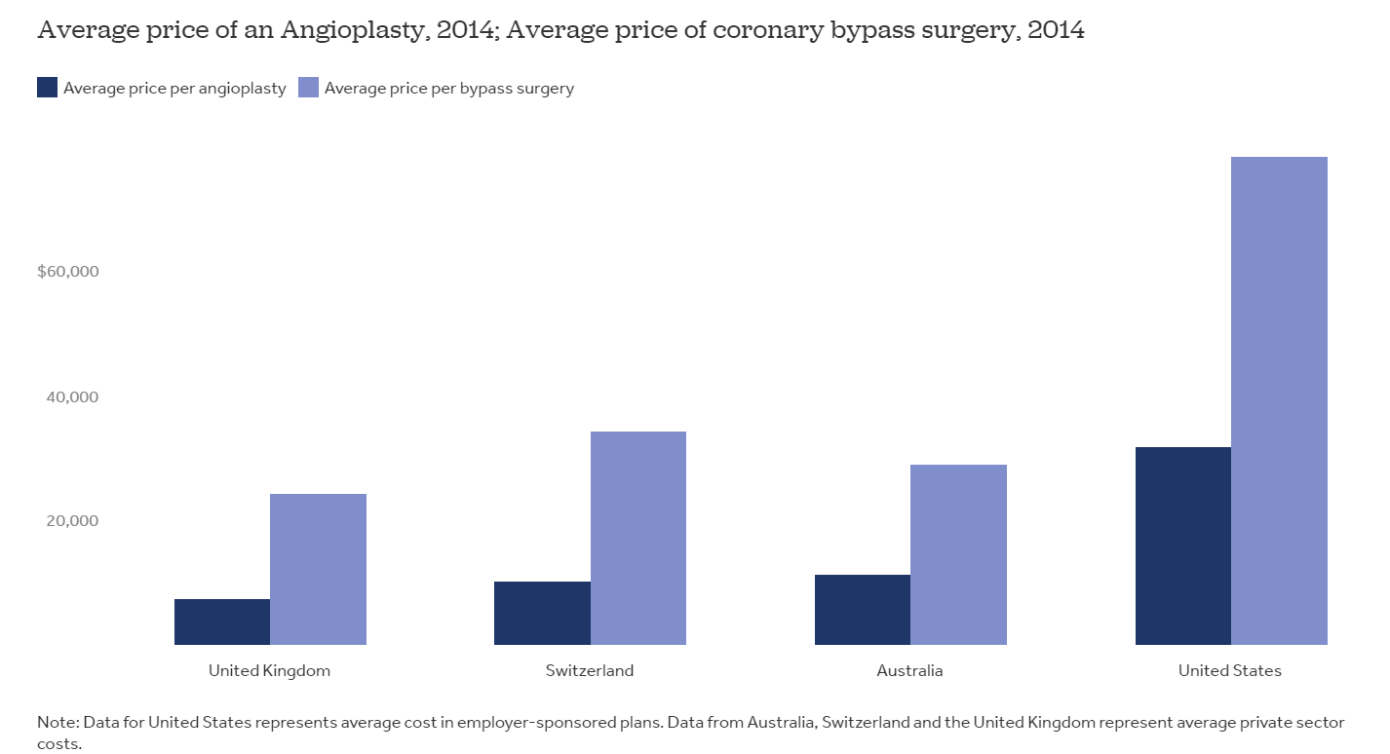
health care Cost comparison
Heart-related Treatments
Angioplasty: a procedure used to open blocked coronary arteries
Bypass surgery: redirect blood around blocked section of an artery in the heart
Notes:
More price comparisons for medical procedures: https://www.nytimes.com/2019/12/27/upshot/expensive-health-care-world-comparison.html

Slide 42

Concentration in US Industries
A market is “concentrated” if CR4 (the share of sales of top-4 companies) is above 50%
https://concentrationcrisis.openmarketsinstitute.org/
Notes:
This website is really cool: https://concentrationcrisis.openmarketsinstitute.org/
You can click on the sector and see how concentrated each market is:

Slide 43
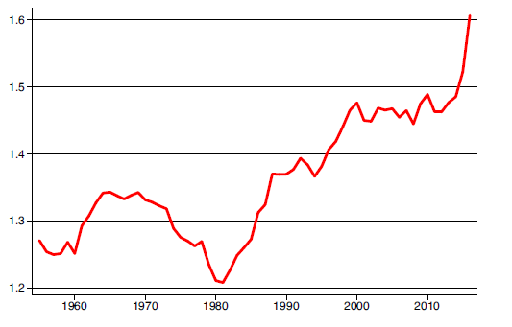
Rising Markups in the US
Average markup (P/MC) in the US economy*
* Source uses the markup definition (P/MC) – this is different from the Lerner index (P-MC)/P.
Note: If Markup=1.5 → Learner index = 0.33
Source: DeLoecker et al, QJE 2020: The Rise of Market Power and the Macroeconomic Implications
Notes:
Source: DeLoecker et al, QJE 2020: The Rise of Market Power and the Macroeconomic Implications
Note: $L=\frac{\frac{P}{MC} − 1}{\frac{P}{MC}}$ . So if $\frac{P}{MC}$ = 1.5 → L=0.33 [Not needed for exam!]

Slide 44
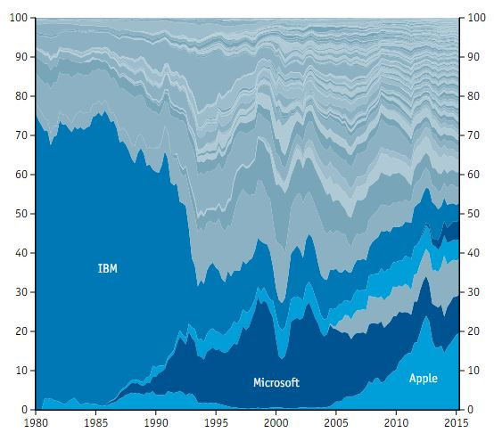
However: all Firms face Potential (future) competitors
Source: http://www.economist.com/techfirms
Notes:
Even if you are the only player on a market, you have to worry about potential entry: contestable markets.

Slide 45

Ultra-Low-Cost Carrier Airlines: Entry Drives down prices
Ultra-low-cost carriers (ULCC)
On routes that ULCC start to fly:
  Prices can fall by double-digits (Chicago, 23%, Newark, 22%, Houston, 21%, Dallas, 20% and Las Vegas, 20%)
  Number of passengers go up
Notes:
ULCC: discussion on page 321 of the textbook
Allegiant, Frontier and Spirit, undercut fares offered by incumbent carriers.
Prices can fall by double digit, number of passengers goes up.
Drop in prices: Chicago O’Hare (23%), Newark (22%), Houston George Bush Intercontinental (21%), Dallas/Fort Worth (20%), Las Vegas McCarran (20%)
The airline sector is very concentrated: Delta (22%), American (21%), United (18%), Southwest (15%)

Slide 46
OUTLINE of module 5
Profit maximization for price searchers
  Markup and Lerner index
Monopoly and welfare impact
Rising market power and regulations
Monopolistic competition

Slide 47
Where We Are
WE ARE HERE
Least Market Power
Most Market Power
Perfect
Competition
Monopolistic
Competition
Oligopoly
Monopoly
(Price Takers)
(Price Searchers)
Restaurants in WeHo

Slide 48
Market structure characteristics
Monopolistic Competition
Number of actual or potential
competitors
Product differentiation
Entry conditions
Profit potential
Examples
Many sellers
Perceived differences but relatively close
substitutes
No (major) barriers to entry
Normal economic profit in long run; losses and
profits in short run only
Professional services (plumbers, gardeners);
restaurants, gas stations; clothing
(How to get market power: Palessi)

Slide 49

MONOPOLISTIC COMPETITION EXAMPLE:
Gas Stations – Product differentiation by location
Notes:
Take gas stations, for example. Even in small towns, there can be dozens of them. While their marketing departments try really hard to tell you otherwise, all the different stations sell the exact same product. However, there is a bit of product differentiation through their locations. The customers prefer to drive to the closest one. For a given customer, this makes some stations more attractive than others.

Slide 50
Monopolistic competition: the role of entry
Monopolistic competition
  Large number of firms
  No (major) entry barriers
Short run: economic profits possible
Long run: entry erodes economic profits

Slide 51
Monopolistic Competition: Short run
P
P*
MC
Profit
ATC
ATC
D
MR
Q
Q*
Notes:
Short run. Firms that differentiate are perpetually looking for those short term profits.

Slide 52
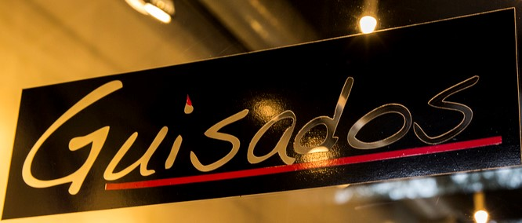


Monopolistic Competition: entry of new firms
Price
New entrants → Demand for incumbent drops and becomes more elastic (D₂)
MC
P2
ATC
ATC
Profit
D1
D2
MR2
Q2
Output
Profits of the incumbent firm decline as more competitors with similar (but differentiated) products enter the monopolistically competitive market.
Notes:
Long run: Entry of new firms makes the incumbent firm’s demand more elastic (less steep) due to the availability of substitutes. Entry of new firms also shifts the incumbent firm’s demand down due to the fact that the firm is now splitting the market. Marginal revenue will shift accordingly.
As long as there are positive profits, more firms will enter. Demand will shift down to where it meets average total cost, so that profits are zero.
Note that the entry of firms does not lead to the perfectly competitive outcome. There is still a price mark up over the MC due to downward sloping demand.

Slide 53
Barriers to entry
Entry erodes profits in a monopolistically competitive market
Different from monopoly
Why?
  No (or low) barriers to entry in monopolistically competitive markets
  Can firms create barriers to entry?

Slide 54





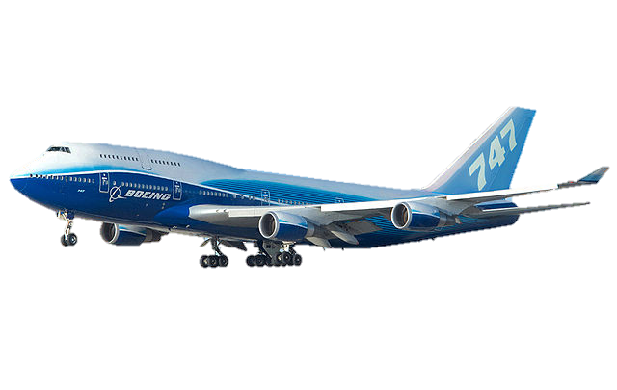
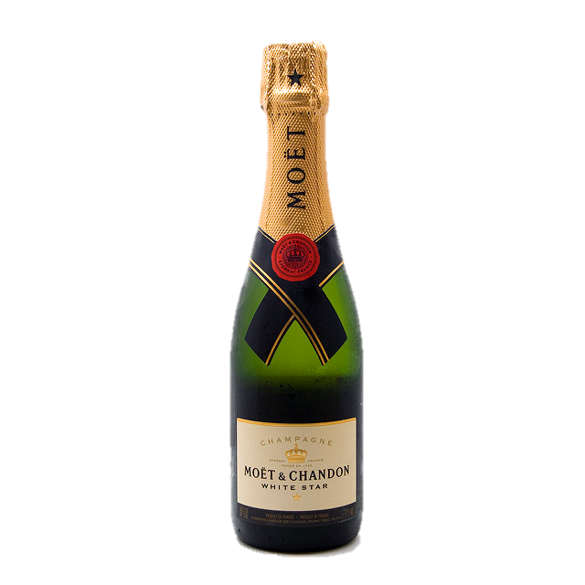
« Structural » barriers to entry
Legal barriers
Network effect
Economies of scale
Learning
Control of resources
Notes:
Example of legal barriers include:
-- licensing requirements
-- taxi medallions
-- patents and copyrights

Slide 55


switching costs Can also raise barriers to Entry
Loyalty programs
Compatibility

Slide 56
Module 5 summary
Profit maximization of a price searcher
  Set MR=MC
  MR≠P
  This methodology applies to both monopoly and monopolistic competition
Monopolist: can make short-term and long-term profits
  Good for business (higher profits), bad for consumers (lower consumer surplus) and welfare (deadweight loss)
Monopolistic competition
  Short-term profits are possible
  Entry erodes economic profit in the long run
Sources of market power: Product differentiation and barriers to entry

